Slide 1
Lab of plotters | group 1 only ai models can prevent forest fires
CU-VIRT-AI-PT-0602024-U-LOLC-MWTH | DATA ANALYSIS, PROJECT 3

Slide 2






TEAM.
Jonathan
Schwartz
Albert
Hernandez
Jordan
Kesner
Yifei
Li
Kala
Sivasubramanian
Frederik
Tylim

Slide 3
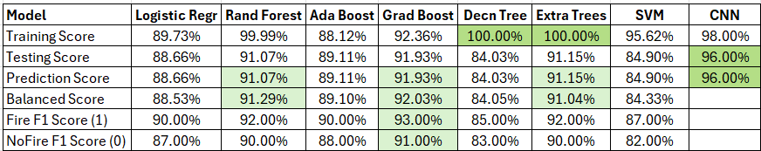
Kala BYO Model
Data Wildfire Prediction Satellite Images
Training images 14,500 no wildfire, 15,750 wildfire
Testing images 2,820 no wildfire, 3,479 wildfire
Validation images 2,820 no wildfire, 3,480 wildfire
Pre-Trained Models
NLP using spaCy and NYT articles via API
Retrieved 10 NYT articles on wildfires – abstracts and lead paragraphs. Most common adjectives: “dry, strong, hard, dangerous, rugged, intense”
Chat using LLM gemini-1.5-flash w/o Conversational Memory Chat using LLM gemini-1.5-flash with Conversational Memory
What are three common causes of wildfire? Ditto
Three common causes of wildfires are:
**Lightning strikes:** Natural ignition sources, …
**Human carelessness:** Discarded cigarettes, …
**Arson:** Deliberately set fires, often for malicious purposes.
What preventive measures should be taken? What preventive measures should be taken?
Depends on *what* you are trying to prevent. I need more context… Preventing wildfires requires a multi-pronged approach, key measures:
Based on wildfire risk, what marketing opportunities exist? **Reducing Ignition Sources:**, * **Responsible Campfire Management:** …
Home improvement, construction, insurance, technology… It's important to remember that wildfire prevention is a shared responsibility….

Slide 4
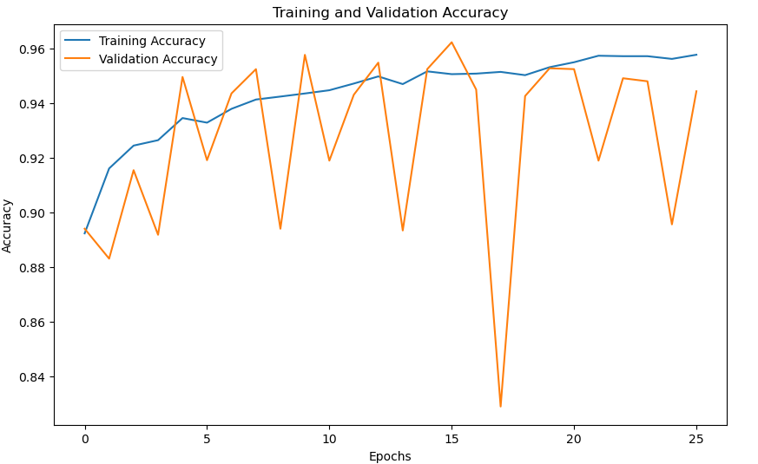
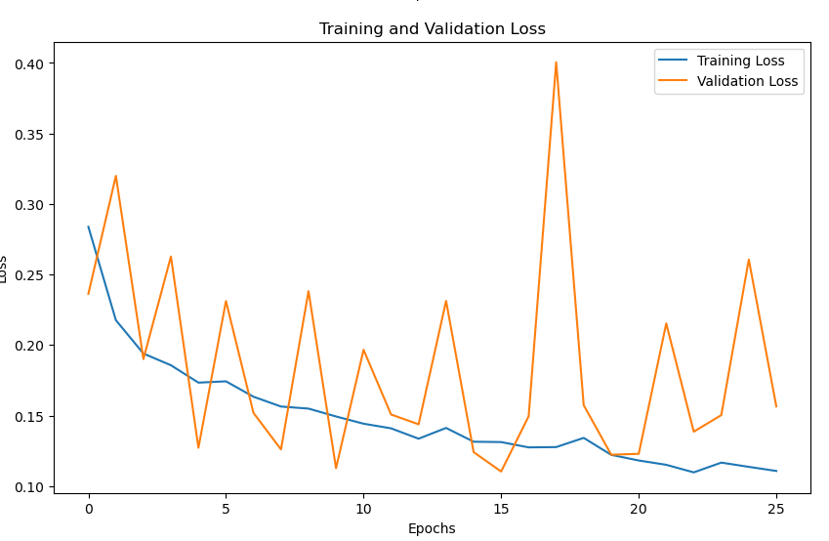
CNN Model
CNN Model
# Evaluate on the test settest_loss, test_accuracy = model.evaluate(x_test, y_test)print(f"Test Loss: {test_loss:.4f}, Test Accuracy: {test_accuracy:.4f}")
Review of the results.
The results indicate how well the CNN model performed on the test dataset.
Test Loss (0.0912). A lower test loss indicates that the model is making predictions close to the actual labels. The lost is quite low indicating the predictions are accurate.
Test Accuracy (0.9681). Indicates the percentage of correct predictions on the test dataset. The accuracy is of 96.81% which indicates approximately an accuracy 97 out of every 100 samples.
Plotting training and validation accuracy also demonstrate visually to assess how well the model is learning during training and whether it generalizes well to validate data. Also looking signs of overfitting, such as training accuracy increasing while validation accurary plateaus or decreases.
Most common adjectives: “dry, strong, hard, dangerous, rugged, intense”
197/197 ━━━━━━━━━━━━━━━━━━━━ 1s 3ms/step - accuracy: 0.9628 - loss: 0.0919 Test Loss: 0.0912, Test Accuracy: 0.9681

Slide 5
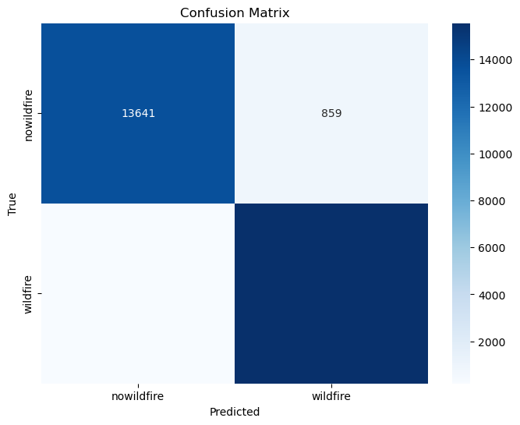
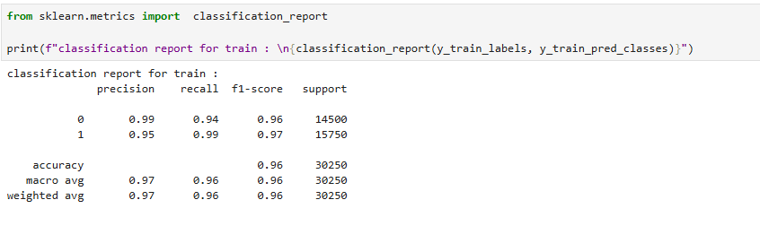
Confusion Model
Confusion Model
Review of the results.
The confusion matrix helps evaluate the model more granularly by showing the counts of actual versus predicted classification.
The classification report summarizes the model’s performance on the training data across the two classes (0=no wildfire and 1=wildfire).
Class 0:
Precision: Out of all predictions class 0 samples, 99% were correctly classified.
Recall: 94% were correctly identified.
F1-Score: Harmonic mean of precission and recall shows a balance between the two metric.
Class 1:
Precision: 95% were correct.
Recall 99% were identified.
F1-score: 97% indicates strong performance.
The results indicate excellent training performance. It is important to keep and eye on overfitting if validation/test metric are worse or significantly worse.

Slide 6
Thank you.
Questions?
Comments?
Concerns ?
Otherwise?

